Slide 1

The Passive Investment Bubble
Damir Tokic
International University of Monaco/INSEEC U Paris
December 20, 2019

Slide 2
Michael Burry – The Big Short
Michael Burry, a hedge fund manager who correctly predicted the housing bubble in 2008 and the resulting financial crisis, believes that there is a passive investment bubble.

Slide 3
Michael Burry – The Big Short
In 2009 active funds had nearly three times more assets under management than passive funds, while in 2019 passive funds overtook active funds by market share

Slide 4
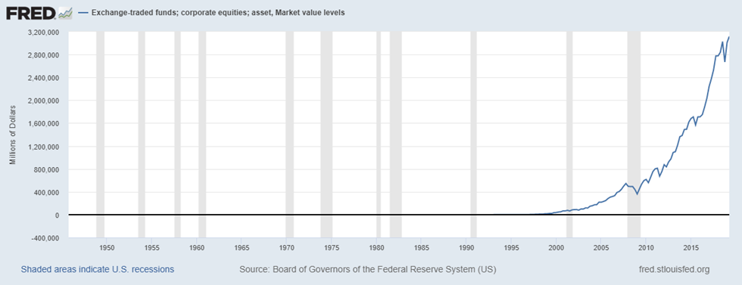
Market value of corporate equity holdings by Exchange Traded Funds

Slide 5
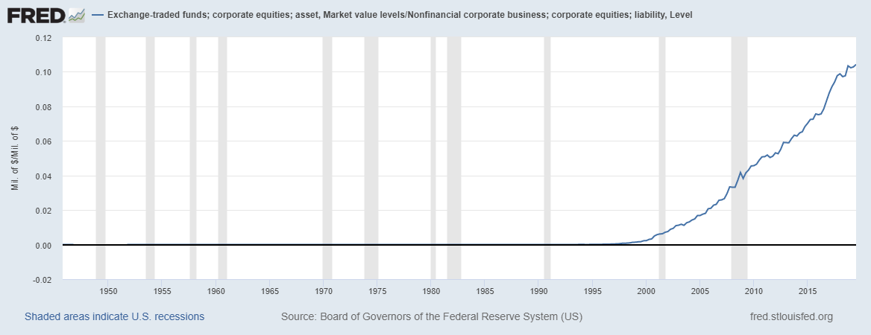
Market value of corporate equity Exchange Traded Funds /Non-financial corporate business corporate equity

Slide 6
The Bubble: Positive-feedback
Delong, at al, (1990) develop a specific model whereby trend followers (or positive feedback traders) buy an asset solely based on its’ historical price trend, disregarding the assets fundamental value.

Slide 7
Active investing strategies and market efficiency
The key argument behind the EMH is based on the existence of rational arbitrageurs, or the market participants that restore any short-lived market inefficiencies - they buy undervalued assets and sell overvalued assets. Thus, a market dominated by these rational arbitrageurs remains efficient.

Slide 8
Passive investment strategies and bubbles
The passive investment funds are design to simply track the performance of a major market index, such as the S&P 500, or other index, factor, or theme.
With respect to passive strategies, it is important to note the term “constant allocation strategy, regardless of a fundament value”, as such strategy can distort the efficient pricing and cause bubbles. For example, Masters (2008) blamed the passive investors in commodity ETFs for the 2008 oil bubble.

Slide 9
Passive investment strategies and bubbles
The passive investment funds are positive feedback traders?

Slide 10
What caused of the passive investment bubble?
The active investment managers significantly under-performed the major market indices since the 2008 financial crisis.
WHY?

Slide 11
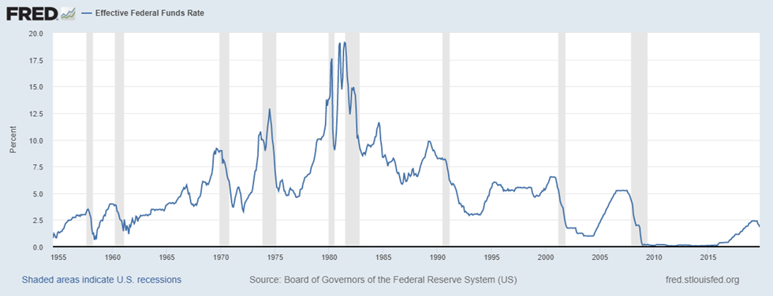
The Fed: Monetary policy

Slide 12
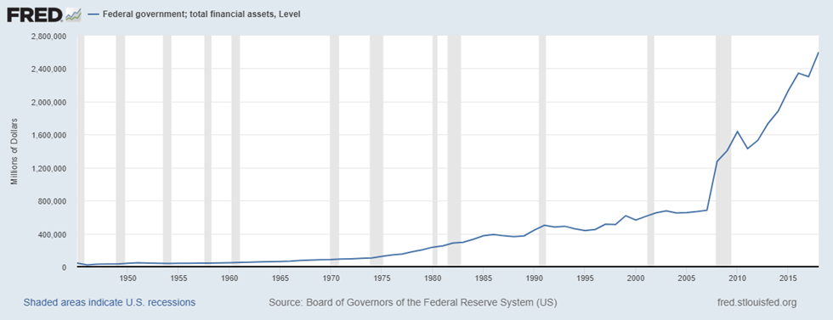
US federal government, total financial assets

Slide 13
Consequences of the passive investment bubble
On the grand scale, the passive investment bubble is just a reflection of the Fed’s post 2008 crisis stimulus.
It potentially reflects the monetary channel designed to strategically inflate the equity prices.
Thus, the consequences of the passive investment bubble have to be view broadly within the systematic risk framework.

Slide 14
Consequences of the passive investment bubble
Investors have been positive-feedback trading to passive funds, or chasing the performance of major market indices.
This is a classic example of a bubble—like behavior, and reflection of systematic wide policies.
However, when the next recession comes, investors will start to reallocate back to active investment managers as major indices start to decline, which will exert heavy indiscriminate selling pressure on the stock market over extended period of time.

Slide 15
Consequences of the passive investment bubble
Thus, given the Fed’s limited ability to counter the next downturn and the lack of liquidity when investors attempt to reallocate back to active managers (or simply sell their ETFs), the next bear market will likely mirror or exceed the sharp sell off during the 2008 financial crisis.

